Slide 1


An AI Enabled Social Distancing Detector

Slide 2

ABOUT US
Manav Vallecha : IRM2017007
Nayan Agarwal : IWM2017501
Shubham : IWM2017004
Aman Gupta : IWM2017006

Slide 3
ABSTRACT
Considering the enormous change that the world is facing, because of the COVID-19, we present a project on an AI based tool to examine the social distancing for roads, parks, workplaces, and even other crowded and jam-packed spots like shopping centers, train stations, etc as social Distancing has proven to be an effective method to curb the spread of CoronaVirus.

Slide 4
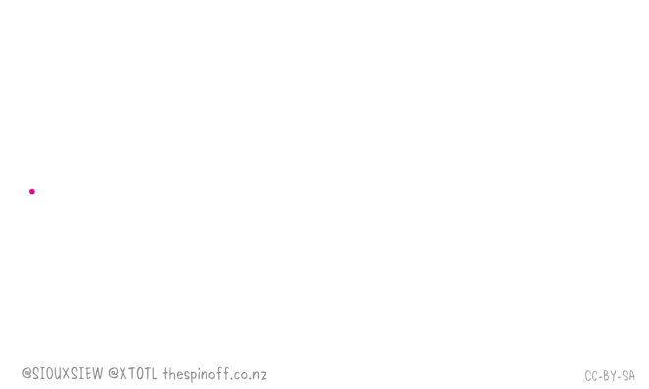
THKS!
Do you have any questions?
youremail@freepik.com
+91 620 421 838
yourcompany.com
Please keep this slide for attribution.

Slide 5
PROBLEM DEFINITION
In the present scenario, life has stopped due to the fear of coronavirus. Even the most powerful economies have been worst hit due to the long lockdown imposed by the nations.Now this motivated us to think about social distancing, and how this problem can be solved if we think from the perspective of Computer Science so we decided to build a social distancing detection tool.

Slide 6
INTRODUCTION
Social Distancing is the key element in our fight against COVID-19.Using modern techniques of deep learning and image processing we have tried to come up with a simple solution that can monitor whether social distancing norms are being followed at a certain place or not.
The project deals with the following points :-
Object Detection and Tracking
Finding Distance

Slide 7
LITERATURE REVIEW
The Paper by S Yadav Deep learning based safe social distancing and face mask detection in public areas for covid-19 safety guidelines adherence . Their system gives an image of the violator to nearby control systems and also gives alert to the violator . Their system uses raspberry pi4 with a camera to automatically track the people in public places . Their model is trained with a custom data set installed in the system and their system is fed with real time video of public spaces . To which if any violator is found they make alerts. The accuracy of their system was 90%
The Paper by N Singh Punn, S K Sonbhadra, S Agarwal Monitoring covid-19 social distancing with person detection and tracking via fine-tuned yolo v3 and deep sort techniques . They calculated the violation index term as the number of peoples to the number of groups formed. They used different object detection techniques like RCNN,YOLOV3 and SSD with balanced performance of mAP and FPS score.

Slide 8
PROPOSED METHODOLOGY
Object Detection and Tracking: Object detection is one of the classical problems in computer vision where you work to recognize what and where — specifically what objects are inside a given image and also where they are in the image.For the object detection part we made use of the You Only Look Once (YOLO)algorithm. YOLO is a clever convolutional neural network (CNN) for doing object detection in real-time. The algorithm applies a single neural network to the full image, and then divides the image into regions and predicts bounding boxes and probabilities for each region.These bounding boxes are weighted by the predicted probabilities.YOLO requires only one forward propagation pass through the neural network to make predictions.

Slide 9
Why we Chose YOLO Algorithm for Object Detection?
With YOLO, a single CNN simultaneously predicts multiple bounding boxes and class probabilities for those boxes. YOLO trains on full images and directly optimizes detection performance.
YOLO is extremely fast
YOLO sees the entire image during training and test time so it implicitly encodes contextual information about classes as well as their appearance.
YOLO learns generalizable representations of objects so that when trained on natural images and tested on artwork, the algorithm outperforms other top detection methods.

Slide 10
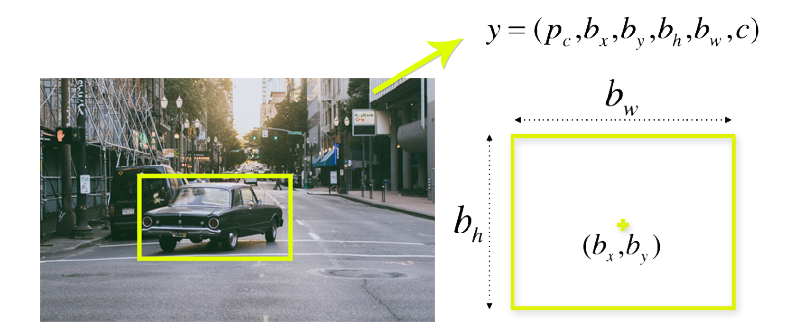
In order to understand the working of Yolo algorithm we need to understand what it predicts in an image frame. Using Yolo our main aim is to predict the class ( i.e.what is the object) and where is the object ( Object Localisation). Each bounding box is described by centroid of that bounding box and the height and width of that bounding box.

Slide 11
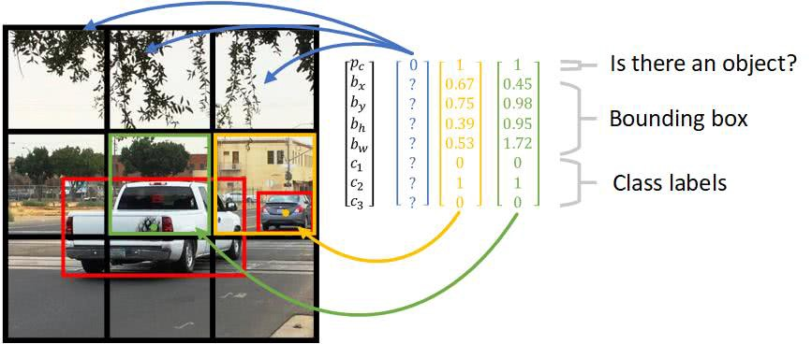
The Yolo algorithm is not searching for the desired region in an image, instead it splits the image into grid cells . Each grid cell is responsible for predicting 5 bounding boxes, and confidence scores for those boxes. These confidence scores reflect how confident the model is that the box contains an object and also how accurate it thinks the box is that it predicts. The below figure shows an image and grid cells and how the yolo predicts the label for corresponding grid cell.

Slide 12
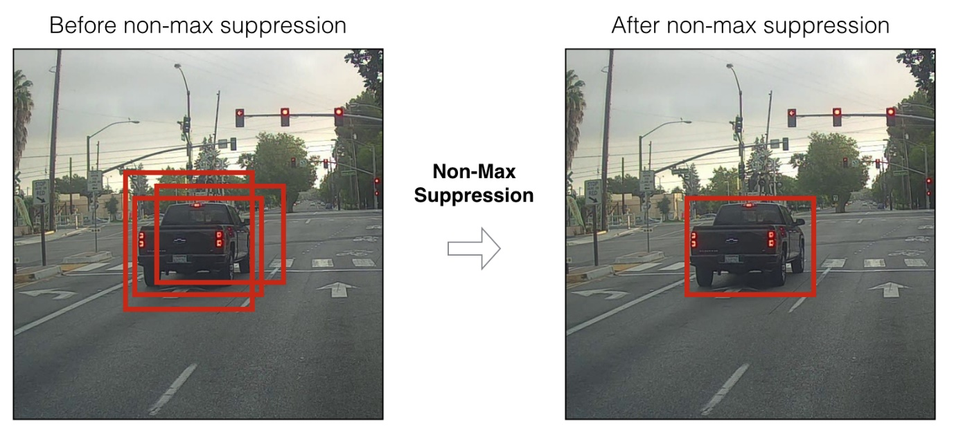
Non-Max Suppression: Since YOLO outputs multiple bounding boxes , and all of them are not useful , we need to filter bounding boxes in order to only have the best detections with us and to do this we use Non-Max Suppression.

Slide 13
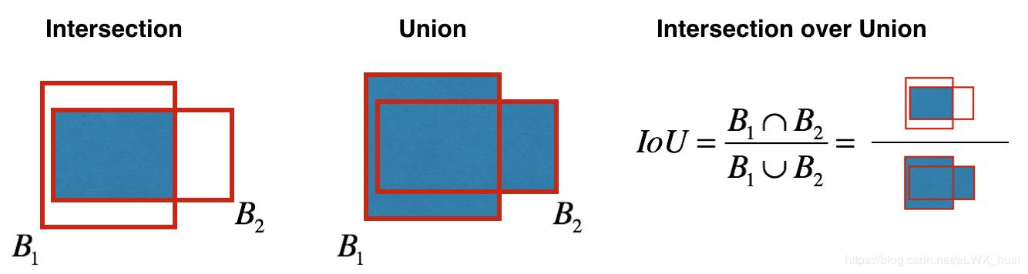
Non-max Suppression finds the bounding box with highest confidence score and then all the bounding boxes having a high Intersection over Union (IOU) with the highest confidence box get suppressed. This is done with a help of a threshold value for IOU, that we set initially.IOU (Intersection Over Union) is defined as the ratio of Area of Intersection of bounding boxes to the Area of their Union.

Slide 14
Distance Finding: After we have these detection results and the centroid coordinates, we compute euclidean distance between each pair of bounding box centroids and compute a distance matrix D. Suppose the centroid at ith index is c1 and centroid at jth index is c2, then
D[i][j] = distance between the bounding boxes of c1 and c2
Based on this we set a certain threshold and find out all the boxes that violate that threshold criteria, we add the bounding box to the social distancing violation category.

Slide 15
After the distance is computed we need to compare it with a threshold distance.
We have the width of all the bounding boxes that is w. We take average width of actual person in inches ( i.e. 27 inches or 0.70 meters) . From this we can get the pixel to metric ratio. R is defined as the number of meters in one pixel
R = 0.70 / W , meter to pixel ratio
Now in the above slide we mentioned D[i][j] is the distance between the bounding boxes of two objects(persons in this case). With the help of R we can find out the approximate distance in meters between the two bounding boxes.
Approx distance = R * D[i][j] in meters.
The distance for maintaining social distancing norms is 6 ft or 1.8 meters . Now the distance can be easily compared and we can classify it as a violation or not.

Slide 16
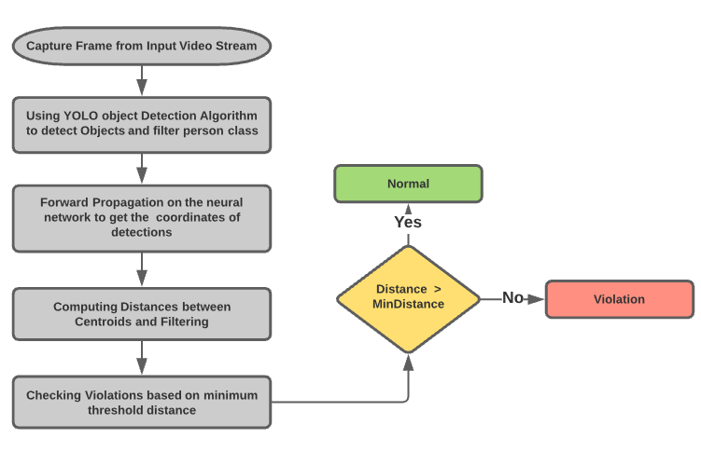

Slide 17
RESULTS
In this project the function that we built for performing object detection on persons
and compute the distance can take input images and perform computation on them.
Also with the help of OpenCV library we can pass the video stream as the input and
in turn generate video output in real time that shows the social distancing violations happening in each frame. We also mark the person’s bounding box as red in order to depict that social distancing norms are violated. And mark those bounding boxes with Alert. Rest all the bounding boxes are marked green. We ran our algorithm on the CCTV footage of pedestrians in a busy downtown area in Oxford that was taken from the Oxford Data Center. As a result we got the output video depicting the result of the social distancing detector that we developed.

Slide 18
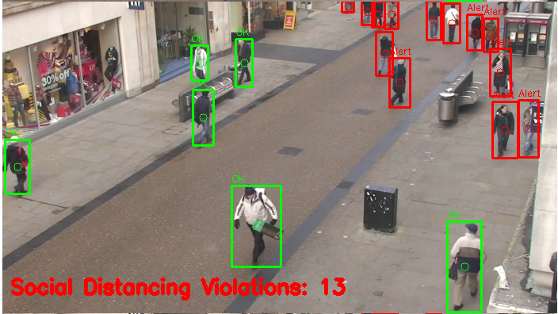
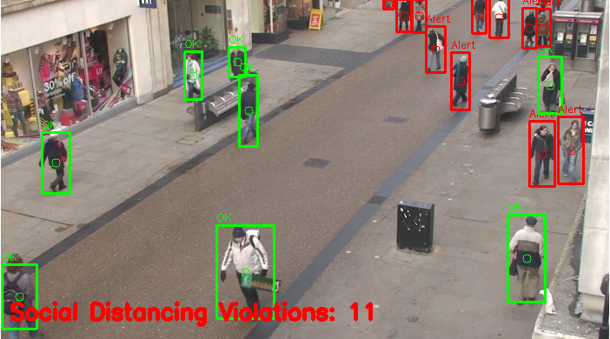
RESULTS

Slide 19
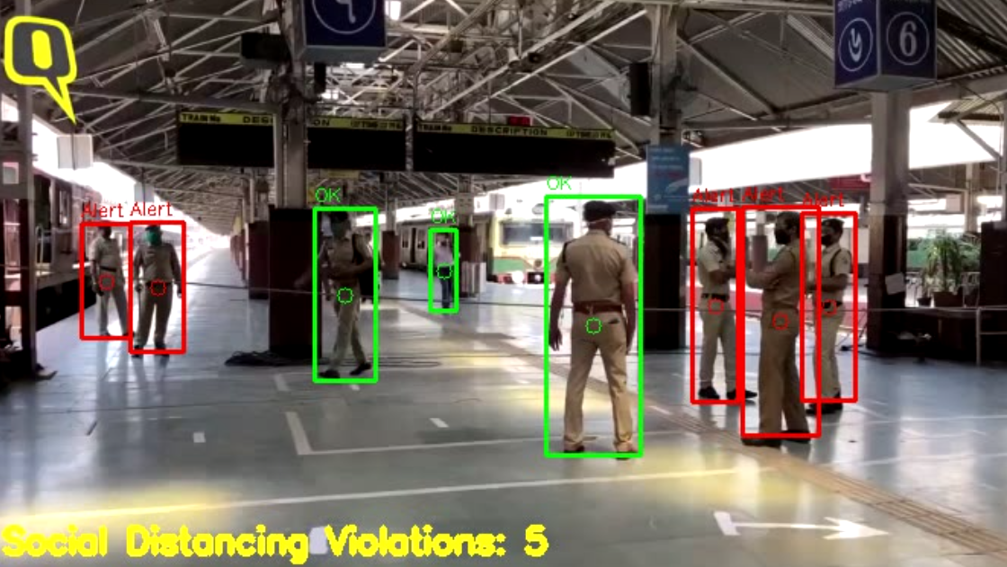
RESULTS

Slide 20
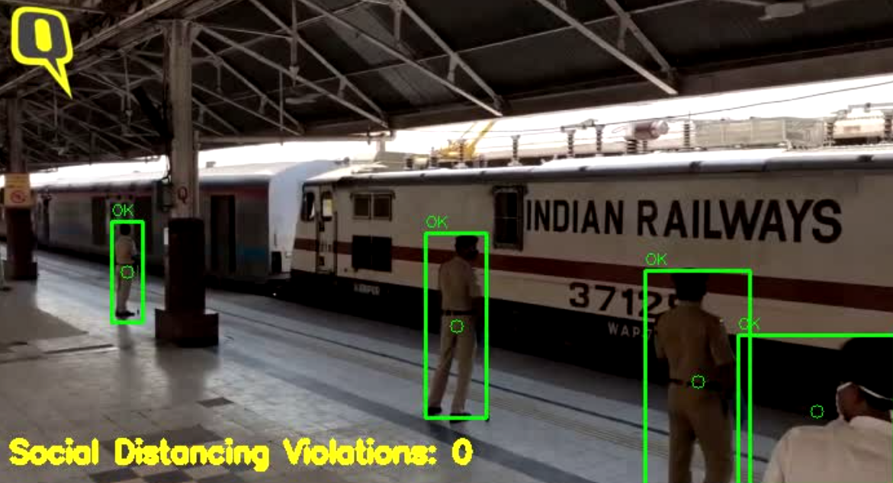
RESULTS

Slide 21
Statistics Comparision
Models | Accuracy(%) | Time(sec/img) | Rate(fps)
R-CNN | 73.2 | 0.11 | 9.1
Faster-RCNN | 83.8 | 2.24 | 0.4
SSD300 | 74.3 | 0.01 | 46
SSD 512 | 76.8 | 0.05 | 19
YOLO | 84.4 | 0.03 | 38
YOLOv2 | 88.6 | 0.03 | 40
YOLOv3 | 89.3 | 0.02 | 45

Slide 22
FUTURE WORK
In order to improve our social distancing detection we need to utilize a proper camera calibration . Doing so will yield better results and enable us to compute actual measurable units (rather than pixels).
We can also have an alert system that gets triggered in a place whenever the number of social distancing violations exceed a certain threshold. If this type of solution is deployed at places then less police workforce have to monitor the situation personally , which in turn will also guarantee the safety of security personnel.
This project can be extended to further give alerts on a mobile via a mobile app, The registered users of the mobile app can be given an alert whenever there are situations of social distancing violations in a place.

Slide 23
CONCLUSION
Through the entire project phase we came across various studies and research papers regarding this topic and other topics specific to the uncertain time we are living in.
We briefly discussed those in the Literature Review section. We discussed how we applied the knowledge of computer vision and deep learning to solve a real world problem . Later we discussed the object detection algorithm that we used and how we built our project. The results that were obtained from our algorithm are presented. We also discussed how we can improve our social distancing detector to become more robust and more applicable in the real world.

Slide 24

TIMELINE
Literature review
20-06-2020 to 25-08-2020
Finalizing Problem Statement and Goals
22-06-2020 to 24-06-2020
24-06-2020 to
25-07-2020
Studying different Object detection techniques
Working on code
25-07-2020 to
26-08-2020
26-08-2020 to
02-09-2020
Preparing report

Slide 25
Thank You

